Slide 1
Cattle Vaccinology Basics
John C Wenzel DVM
Extension Veterinarian
NMSU
jwenzel@nmsu.edu
Cattleman’s College
Joint Stockmans Meeting
Albuquerque, NM
December 9, 2025

Slide 2
Innate Immune Response
Present at birth
Some individuals may be born with more or better “natural” resistance than others.
Non specific: not targeted to a specific
harmful agent
1st levels of defense
Non specific: Mechanical
Non specific: Natural chemical and cellular immunity

Slide 3
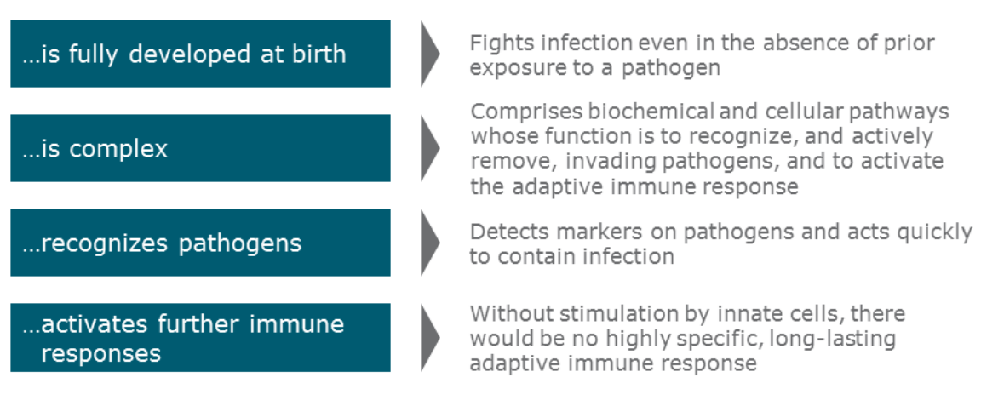
Innate Immune System

Slide 4
Acquired or “Adaptive” Immune Defenses
Acquired after birth (requires exposure to an “antigen”).
Protection is targeted to a specific foreign agent:
Lepto pomona vs Lepto hardjo vs Clostridium perfringens type C vs Clostridium sordelli vs tetanus toxin vs Mannheimia toxin vs K99 E. coli … etc. etc. etc.
Even more complicated than innate defenses.
Dependent upon “lymphocytes” to operate.
Has unique feature of creating “memory”.

Slide 5
Immunity
Primary vaccination may only provide memory with very little antibody production so very little immunity is stimulated
Booster vaccinations act, when memory is in place, to create a much larger immune response
Vaccination does not equal immunity- Our goal is to immunize, not just vaccinate

Slide 6
Vaccination Vaccines protect populations by protecting individuals, but are limited in their ability to protect an individual in an unprotected population.
Falkner

Slide 7
Disease and Resistance
Level of Resistance
Relative Level
Clinical Disease
Level of Challenge
Time
Notes:
This slide is used to introduce the concept of disease and resistance as being a dynamic processes, the interaction of which results in presence or absence of clinical disease. It is important to clearly establish this relationship because it is fundamental to a good understanding of what we are trying to accomplish when we institute management practices that are intended to control disease. Multiple examples of events that cause change in one or the other of these two processes is generally helpful. Not depicted here is the fact that resistance and challenge fluctuation in time. Often these fluctuations are not in concert.

Slide 8
Challenge Level
Susceptible
Non-Susceptible
Notes:
The next three slides are used to develop an understanding of how challenge level relates to the number of animals that would be susceptible or not susceptible to disease relative to the level of challenge. Here again use as many examples of real life situations as necessary to get understanding in the audience. You can generally tell by the level of involvement.

Slide 9
Challenge Level
Before Vaccination
After Vaccination
Susceptible
Non-Susceptible
Notes:
This slide is used to introduce the concept of herd immunity. It is important to establish that vaccination is used to modify (increase) the number of animals that would be considered non-susceptible at a given challenge level as compared to the original population. You can go into the concept of controlling epidemic disease based on increased resistance in the herd even though there are susceptible animals in the group.

Slide 10
Developing Immunity in Calves
Develop a sound vaccination/ preventative health program with your veterinarian
If you raise your replacement heifers, start as calves to prepare for motherhood, at branding
If you purchase replacement heifers, try to start on a MLV program prior to breeding
If you purchase bred replacements, look at using vaccines that are chemically altered

Slide 11
Vaccination
-Need to be specific for area and operation
-A vaccination program is one segment of a total herd health program
-Vaccination programs need to be designed with your specific management practices in mind
-Consult your local Veterinarian to design a herd health program for your operation

Slide 12
Vaccine Types
MLV- modified live viral vaccine
Virus replicates in body
Better cross protection (core proteins)
More robust immune response (CMI)
Longer duration of immunity
Higher Risk- viral shedding??
post vaccinal fever
more complicated label restrictions

Slide 13
Vaccine Types- Hybrid
Chemically Altered-(IBR, PI3 ) or Hybrid (Repro-FP)
MLV- BRSV, Killed BVD
Limited viral replication
Safe for all stages of pregnancy
Adjuvant system- enhanced colostral immunity
More expensive, not as convenient, killed BVD

Slide 14
Intranasal vaccine
Chemically altered IBR, PI3; MLV BRSV (No BVD)
Mucosal tissue contains more than 80% of the body’s immune cells
Immediate protection by stimulating mucosal response and interferon release at the site of infection
Primes the immune system for a strong memory response for faster, more robust long term protection
Both local and systemic immunity is important in controlling disease
For respiratory protection; however, local immunity is more important in early stages of respiratory infection!

Slide 15
Vaccine Types
Killed Viral vaccine
Highest safety factor
Multi-dose vials, no mixing
Two doses to start
Least immune response
No viral replication- won’t trigger CMI unless previous MLV vaccine

Slide 16
Vaccination
CALVES-AT BRANDING
7 or 8 Way Blackleg
1st MLV for IBR, BVD, PI3, BRSV
Other vaccinations may be necessary

Slide 17
Vaccination
Pre weaning vs. Weaning Programs
Pre weaning is better due to less stress
Booster vaccinations given 3-4 wks prior to weaning
Much better immune response
Booster MLV vaccs – IBR, BVD, PI3, BRSV
Give primary Mannheimia vaccination
Deworming
+/- 7 way, other vaccs if necessary

Slide 18
Vaccination
Weaning Program- Wean on the ranch
Let calves set overnight prior to processing
Booster MLV vaccs-IBR, BVD, PI3, BRSV
Primary vaccination of Mannheimia
May booster 7 Way vacc (+/- H.Somnus)
Booster MLV vacc again 30 – 45 days post weaning
Deworming

Slide 19
Vaccination
Goals for calf:
- two or three MLV for shipping fever
- one or two Mannheimia vaccs
- one or two 7-way vaccs (H.Somnus ?)
- deworming
- other vaccs as necessary

Slide 20
Vaccination
Cowherd Vaccinations
Spring or fall vaccination schedule
Vaccinate both cows and bulls
Viral vaccs- IBR, BVD, PI3, BRSV
Bacterial vaccs- vibrio, lepto
Other vaccs- Trich?
Deworming

Slide 21
Summary
Vaccination does not equal immunity- always try to “Immunize”
Little things matter- stockmanship and stress, keep cool, out of sunlight, swirl, only mix for 1 hour, follow BQA principles
Effective herd health management programs must be comprehensive and not rely too much on product solutions
Preparation of replacement heifers is the key.
Start preparing replacements heifers as calves at branding

Slide 22
QUESTIONS ??
THANKS FOR LISTENING !!!!

