Slide 1
Building Immunity to Fight Disease
Update on Current Vaccine Protocols
JP Pollreisz, DVM
Zoetis
December 2025

Slide 2
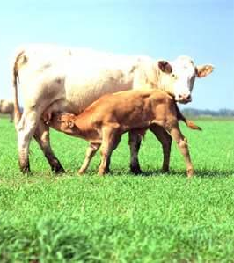
Mama Sets the Stage!
Cows provide immunity to calves and set stage for calf’s own resistance
Fetal programming
Can also be source of ongoing disease
“If you’re having problems with calves, look at the cows!”

Slide 3
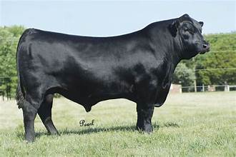
Bulls
Most impactful individual in the herd!
BSE!
Conformation!
Prebreeding vaccinations to prevent infection and spread

Slide 4
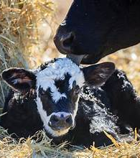
Calves at Birth
Immature immune system
Overeating disease
Scours
Stress/exposure
Intensive synch programs of cows

Slide 5
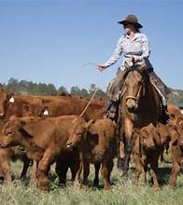
Calves at Branding
Maternal antibody blockage
Main challenges in your herd
Prime/boost
BVD PI testing opportunity

Slide 6
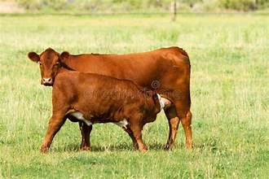
Calves at Preconditioning
Still on the cow
Label considerations
Prime/boost

Slide 7
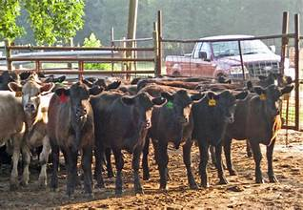
Calves at Weaning
Respiratory disease prevention and management
Nutrition
Begin to develop replacements

Slide 8
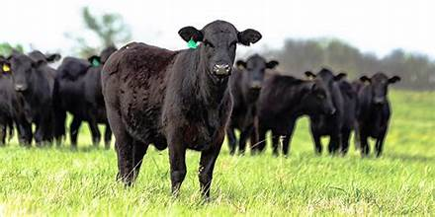
Prep Replacements
Foundation for Future
Weaning and prebreeding at least
Prime/boost
BVD PI test

Slide 9
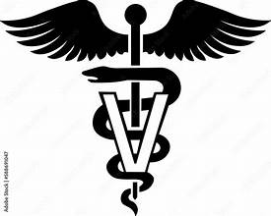
Herd Specific Needs
Pinkeye
Scours
Histophilus
Trichomonas
Anaplasma
Foot Hill Abortion

Slide 10
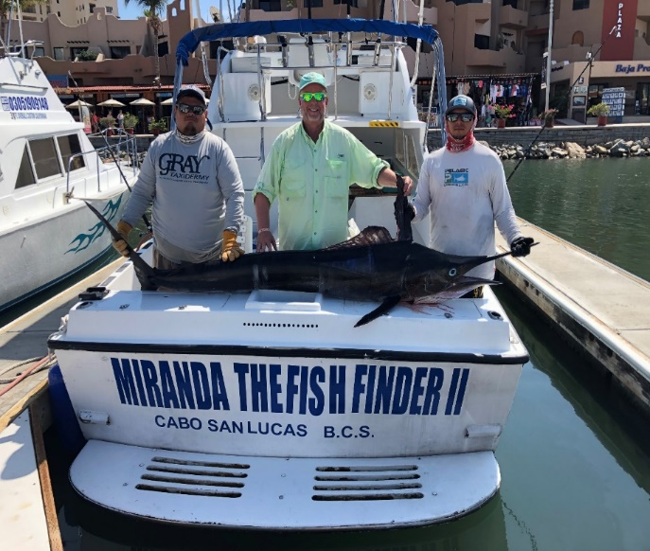
THANKS!
“JP” Pollreisz, DVM
(806) 654-7284 john.pollreisz@zoetis.com

